Slide 1
About My Toy Store
Welcome to our online toy store, your one-stop shop for all things fun and imaginative. We offer a wide selection of toys for children of all ages, from classic wooden toys to the latest tech gadgets.

Slide 2
Our Product Offerings
1
Educational Toys
2
Creative Toys
3
Outdoor Toys
Stimulate your child's mind with our selection of educational toys, such as building blocks, puzzles, and science kits.
Spark your child's imagination with art supplies, play-doh, and pretend play sets.
Encourage active play with bikes, scooters, and outdoor games.
4
Video Games & Tech
Keep your kids entertained with the latest video games, consoles, and other tech toys.

Slide 3
Why Shop with Us
Wide Selection
Competitive Prices
Excellent Customer Service
We offer a vast selection of toys to choose from, ensuring you find the perfect gift for every child.
We strive to offer the best prices on our toys, making it easy to find great deals.
Our friendly and knowledgeable customer service team is always happy to help with any questions or concerns.

Slide 4

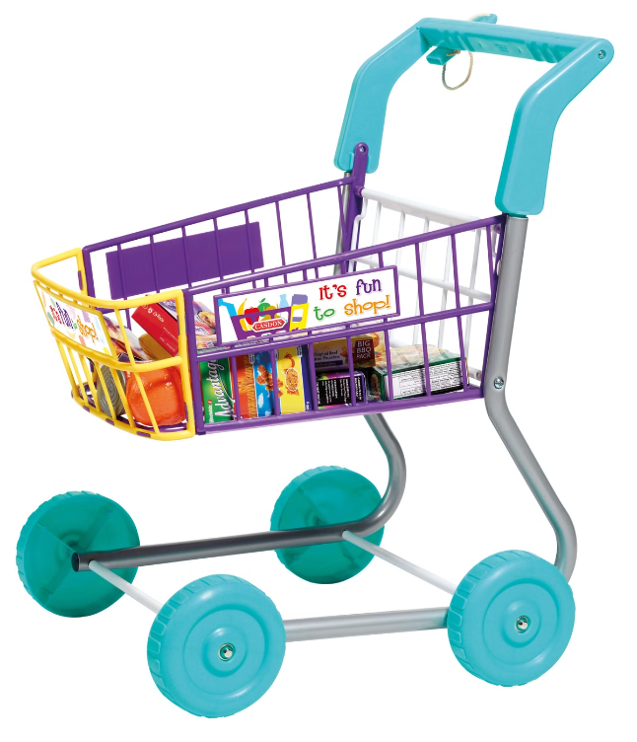



How to Order
Browse Our Catalog
Explore our website and discover the perfect toys for your little ones.
Add to Cart
Select the toys you want and add them to your shopping cart.
Checkout & Payment
Proceed to checkout and securely enter your payment information.

